Slide 1

MSDS 498 CAPSTONE Dan Kuratko

Slide 2
MY PROJECT
PROJECT 3 CLOUD MAPREDUCE
Project Objectives
Implement Chapter 16 in Python for Programmers on MS Azure
Port the same example to run on Google Cloud Platform
Specific Objectives
Manipulate SQL relational database
Store tweets in a MongoDB NoSQL JSON database, visualize via Folium map
Execute Hadoop MapReduce using MS Azure HDInsight and GCP
Use Apache Spark to process data in mini-batches with Azure and GCP
Visualize IoT data via publish/subscribe model

Slide 3
SQL and NoSQL

Slide 4
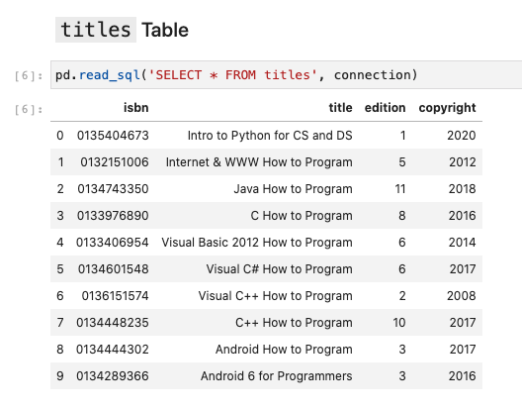
SQL
Review of SQL fundamentals
Book database example
SQLite library within Python

Slide 5
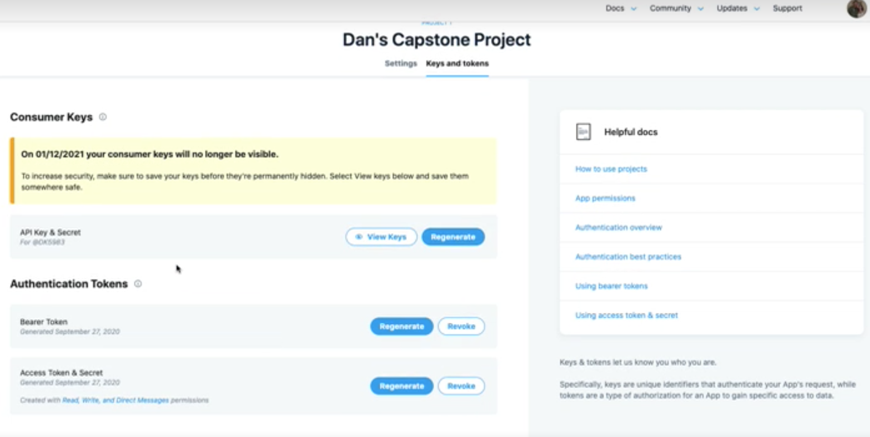
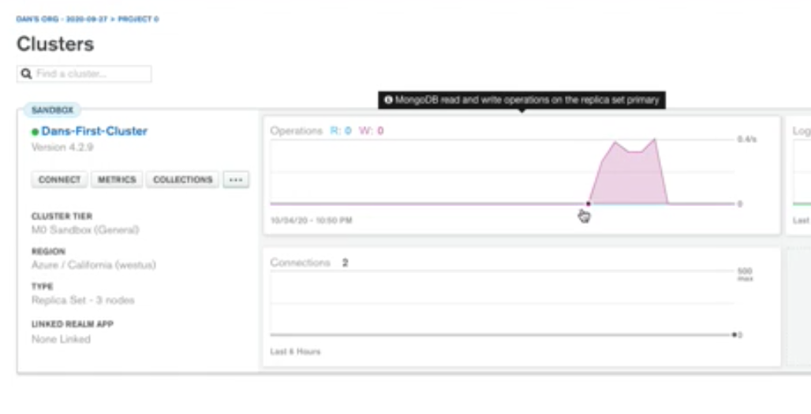
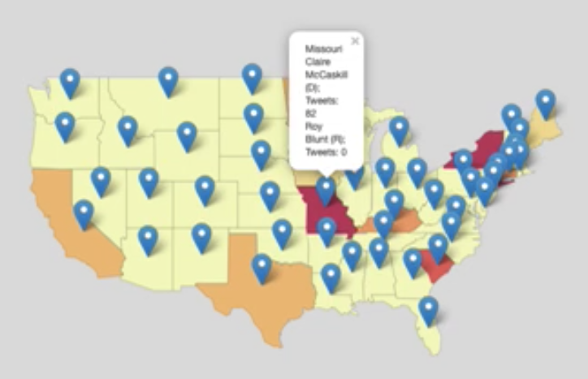
NoSQL
Create a MongoDB Atlas Cluster
Tweet Streaming with Tweepy
Use Folium maps to visualize tweet density

Slide 6
Hadoop MapReduce
With MS Azure HDInsight

Slide 7
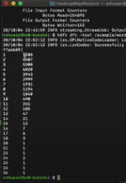
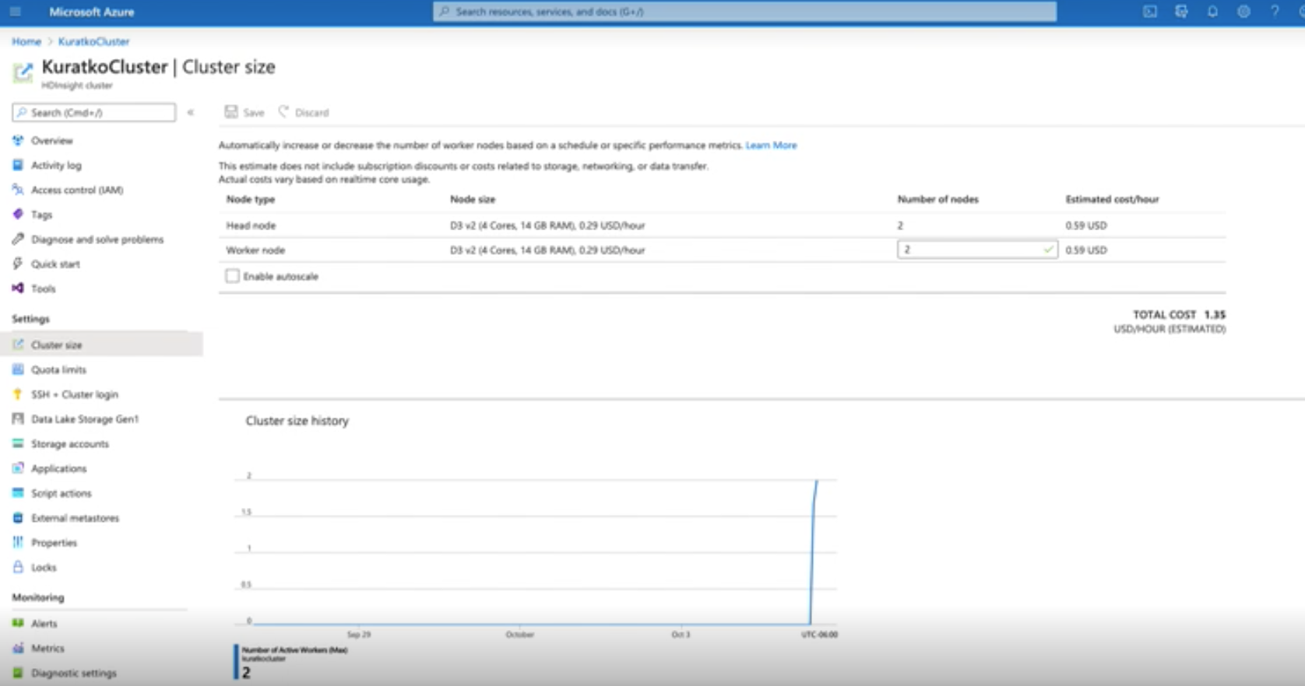
MapReduce Word Count
Create Azure HDInsight multi-node cluster
Run Hadoop MapReduce on this cluster
Case study: Romeo and Juliet word count

Slide 8
Apache Spark
Employing a Docker stack

Slide 9
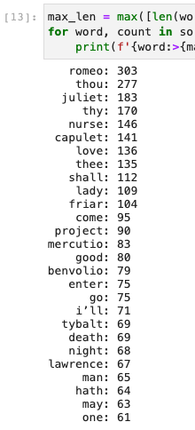
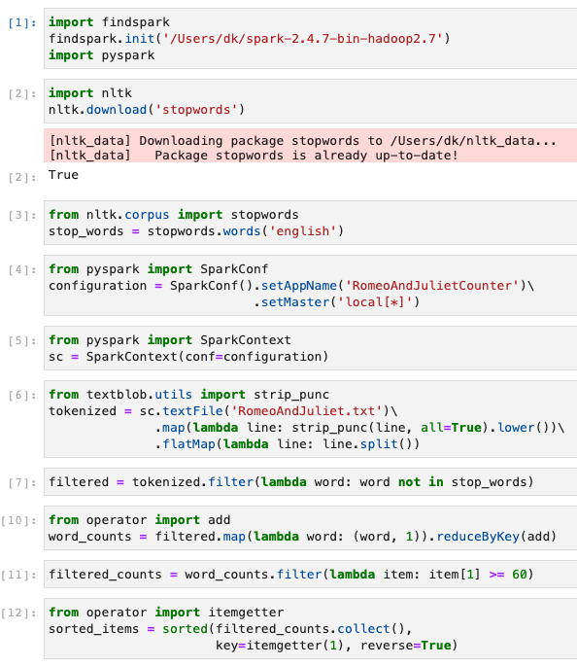
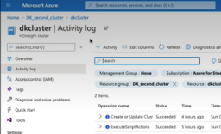

MapReduce with Spark
Execute a Docker stack with Spark and PySpark
Run Hadoop MapReduce on this cluster
Case study: Romeo and Juliet word count

Slide 10
IoT and Dashboards
Visualizing live data streams

Slide 11
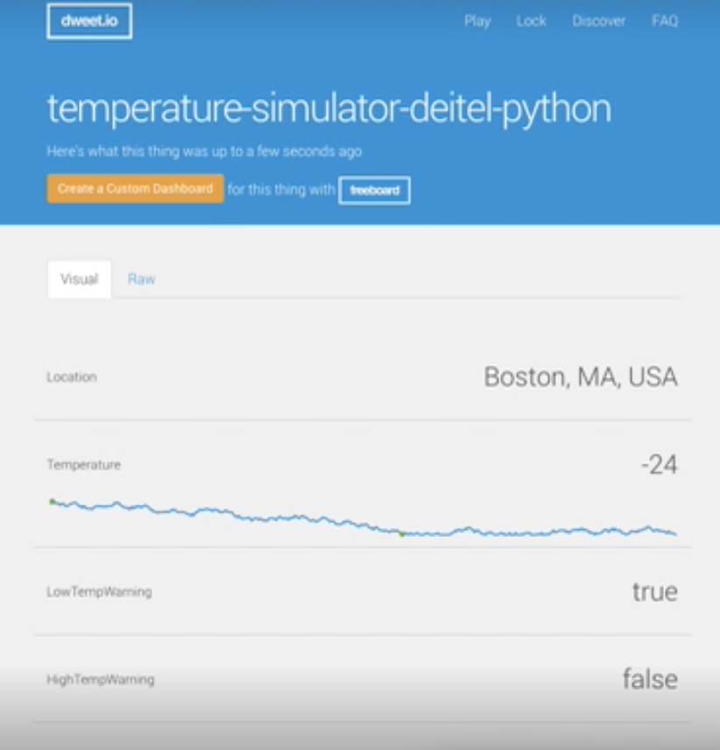
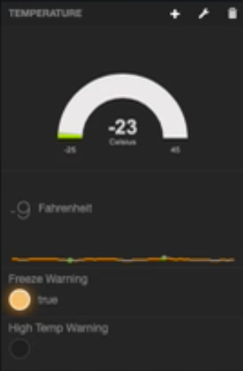
Live Data Visualization
Visualize simulated PubNub data with Freeboard.io
Simulate IoT thermostat using JSON ”dweets”

Slide 12
Hadoop with Google
Replicating a MapReduce in GCP

Slide 13
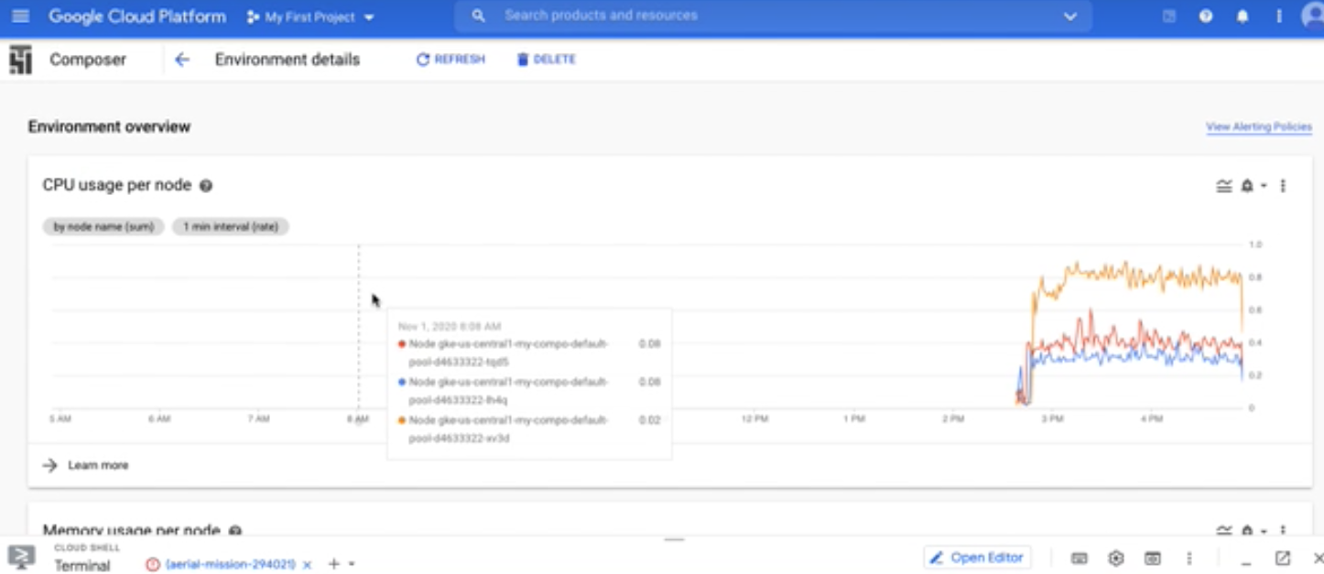
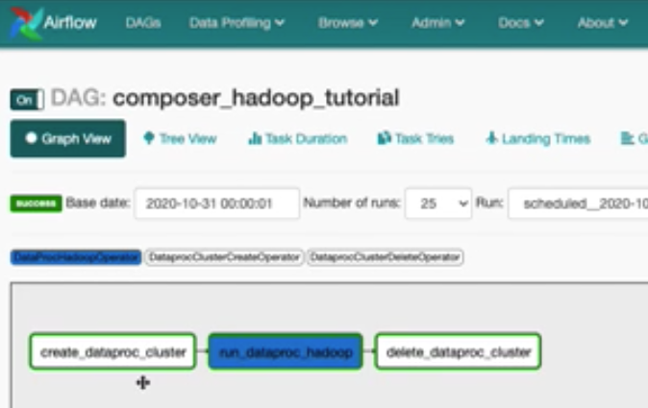
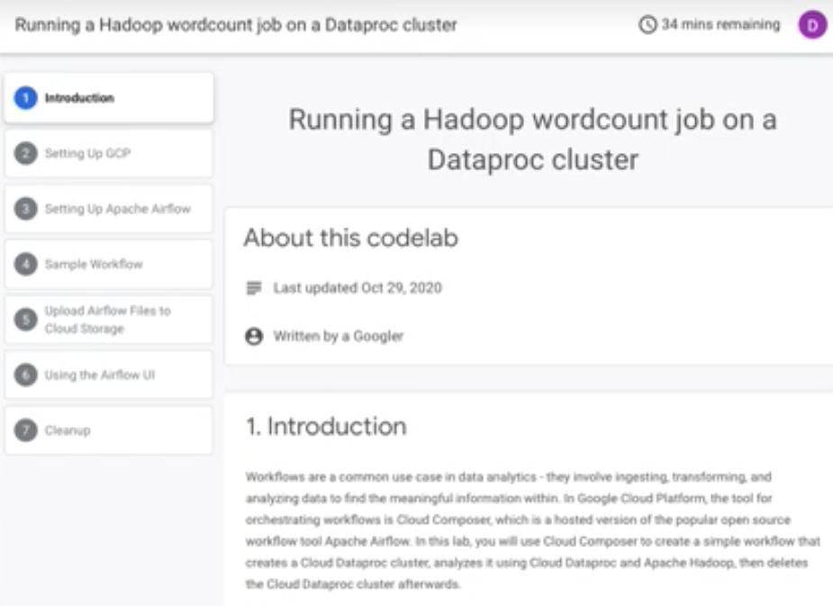
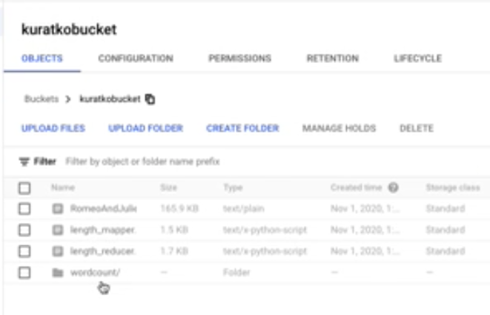
MapReduce with GCP
GCP Dataproc cluster, composer environment, storage bucket
Word count harnessing GCP and Apache Airflow

Slide 14
Spark and GCP
Apache Spark word count in GCP

Slide 15
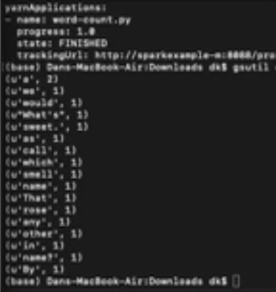
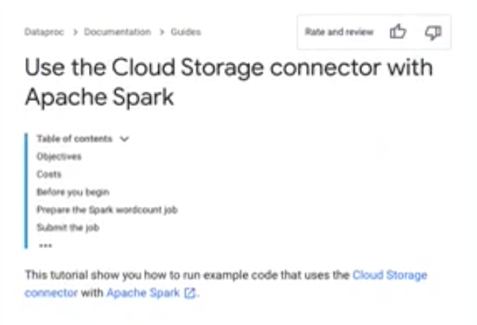
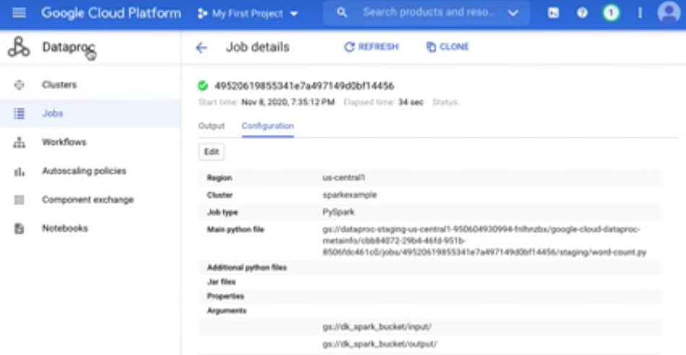
Spark MapReduce with GCP
Same word count example using Apache Spark

Slide 16

THANK YOU!
Dan Kuratko
dankuratko@gmail.com
(619)-618-5093

